Slide 1




The Crime Detectives
Natasha Arokium
Jiffar Abakoyas
Bethold Owusu
Thierno Diallo

Slide 2
NYPD arrest data Analysis 2019
NYC has been ranked #25 with the most violent crime rates in the United States.
In this project we attempt to classify NYC arrests by predicting their level of severity (Felony or Misdemeanor) using other known features from the arrest.

Slide 3





NYPD made 213,089 arrests in 2019

Slide 4
Principal features for analysis
Level of Offense (target feature)
Borough of arrest
Precinct where the arrest occurred
Perpetrator’s sex description
Perpetrators' race description
Date of the arrest
Most frequently occurring arrests/locations on the map/month

Slide 5
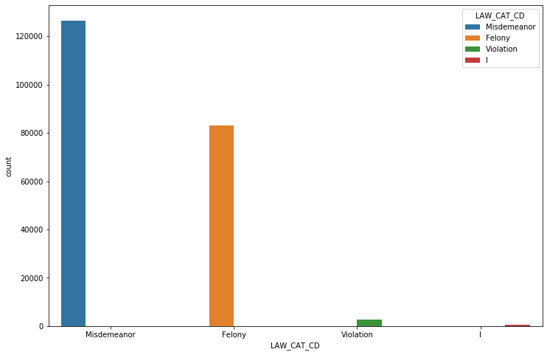
Arrests by Level of Crime
In [30]:
Level Of Arrest | Count | Percent
Misdemeanor | 126590 | 59.41%
Felony | 83244 | 39.07%
Violation | 2822 | 1.32%
I | 433 | 0.2%
Notes:
More of the arrests were for minor offenses(Misdemeanor)

Slide 6
Most frequently occurring arrests by description
ARREST DESCRIPTION | COUNTS | PERCENT
ASSAULT 3 & RELATED OFFENSES | 31988 | 15.01%
PETIT LARCENY | 21627 | 10.15%
DANGEROUS DRUGS | 21071 | 9.89%
FELONY ASSAULT | 15208 | 7.14%
VEHICLE AND TRAFFIC LAWS | 14243 | 6.68%
... | ... | ...
HOMICIDE-NEGLIGENT-VEHICLE | 5 | 0.0%
PARKING OFFENSES | 3 | 0.0%
NYS LAWS-UNCLASSIFIED VIOLATION | 2 | 0.0%
LOITERING FOR DRUG PURPOSES | 2 | 0.0%
UNLAWFUL POSS. WEAP. ON SCHOOL | 1 | 0.0%
Notes:
Assaults 3 & related offenses to the list of most frequently occurring arrests by description

Slide 7
Arrests by Borough
Notes:
Brooklyn recorded the highest number of arrests. Analysis shows that Staten Island is the safest Borough in New York City.

Slide 8
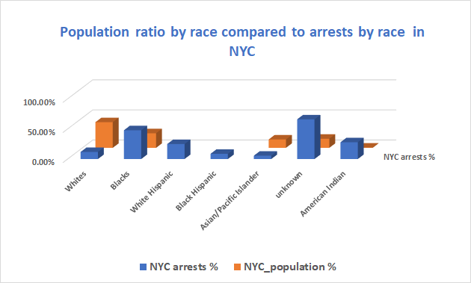
Notes:
According to the most recent ACS, the racial composition of New York City was:
White: 42.67%, Black or African American: 24.27%, Other race: 15.12%, Asian: 13.95%, Two or more races: 3.51%, Native American: 0.43%, Native Hawaiian or Pacific Islander: 0.05% as shown

Slide 9
Arrests by Race & Level of Crime
Notes:
Brooklyn recorded the highest number of arrests. Analysis shows that Staten Island is the safest Borough in New York City.

Slide 10
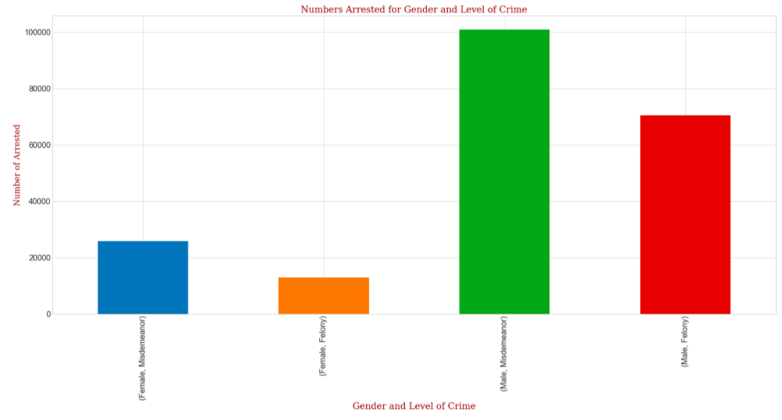
Arrests by Gender
Sex | Count | Percent
M | 173964 | 81.64%
F | 39125 | 18.36%
Notes:
There are approximately 4 times more males arrested than females

Slide 11
Arrests by Age & Type of Crime
Notes:
There are approximately 4 times more males arrested than females

Slide 12
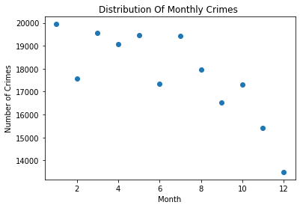
Arrests by month
Notes:
The chart shows a gradual decline in Arrests during the year. With January having the highest arrests, with a high and steady level in March, May, July . December have the lowest Arrests.

Slide 13
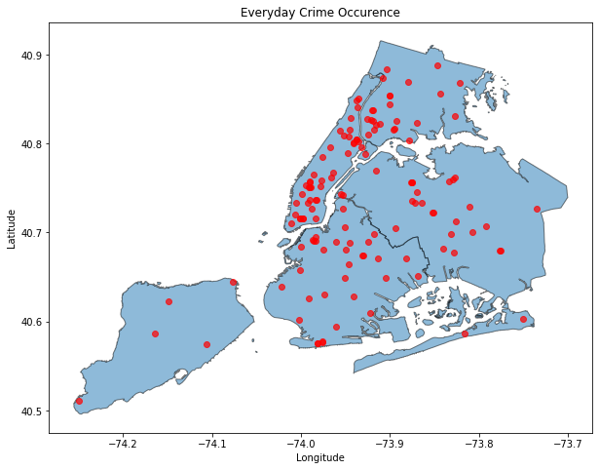
Algorithm to see where crimes occur daily
ALBEE square (BK)
Queens boulevard expressway
Rockefeller center
FULTON MALL (BK)
Gateway dr
Nostrand subway station
Jfk airport
Trans Manhattan exp
Bartow ave (coop city mall)

Slide 14
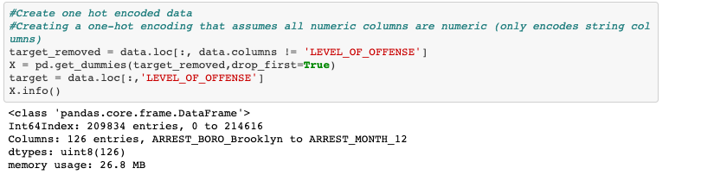
One Hot Encoding: Because the numeric columns contain internal NYPD codes and are not measurements, for our model every column is treated as nominal categorical for our classification (i.e: there is no ordering to the values)

Slide 15
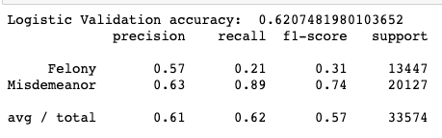
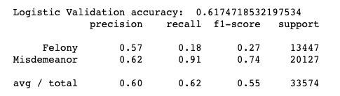
Dummy Classifier Logistic Classifier
Logistic with PCA (45 components)

Slide 16
Grid Search Best Parameters
5fold Cross-val mean: 0.62686, std: 0.00273,
params: {'class_weight': None, 'multi_class': 'multinomial', 'solver': 'newton-cg’}
The above were grid search best parameters for logistic regression with different parameters. The performance did not increase significantly from initial results.

Slide 17
Support Vector Machine
SVM performance was almost identical to that of Logistic Regression for all measures:
precision, recall and f1-score.

Slide 18
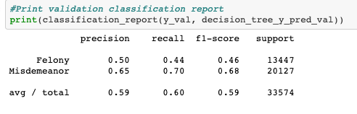
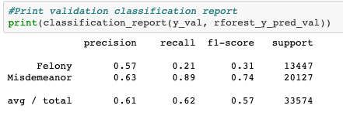
Decision Tree Random Forest
Both Decision tree and Random Forest models performed similarly to Logistic Regression and/or SVM.
Although Random Forest did show significant increase in misdemeanor recall compared to Decision Tree,
however it performed worse in recall for felony class.

Slide 19
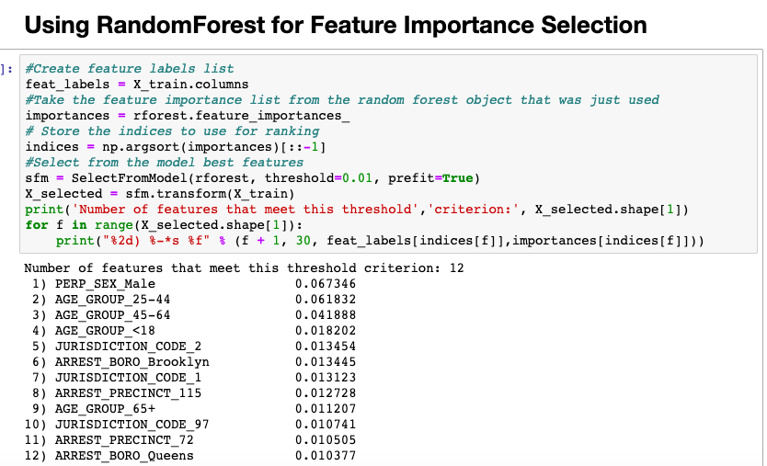
Random Forest Feature Importance
Using Random Forest and the feature importance based on information gain, were able to confirm that features of importance included being male and being in specific age groups. The arrest borough was also a feature of importance, as well as the arresting precinct.

Slide 20
Our ML Classifier Workflow
Cross Validation
Tuning Parameters
Model’s Constants
Uses
Preprocess Data
Input
Train and Test
Output
Best model and Performance
User will preprocess the data to have a features data set and target column
User will call our train_test function by selecting model type
The function will call cross validation on the chosen model tuning parameters
User get back the best model trained for the optimal parameter and the performance on test set.

Slide 21
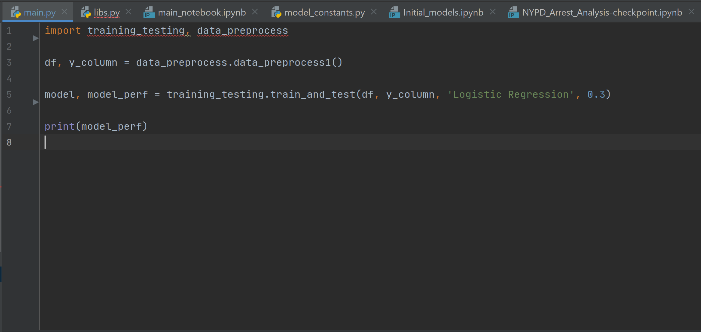
Sample Use of the Classifier
Call the preprocess function
Call the train test function

Slide 22
Machine Learning Takeaway
All the features ( Race, Age Group, gender, Borough) we looked at were not good predictor of the target variable (type of crime)
All the model we tried gave us precisions below 0.70
Our Dataset was not a good fit for machine learning

Slide 23
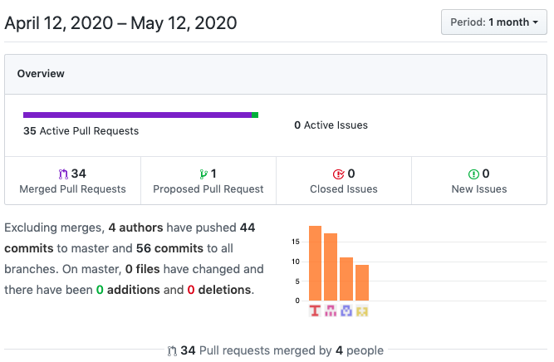
Project Stats

Slide 24
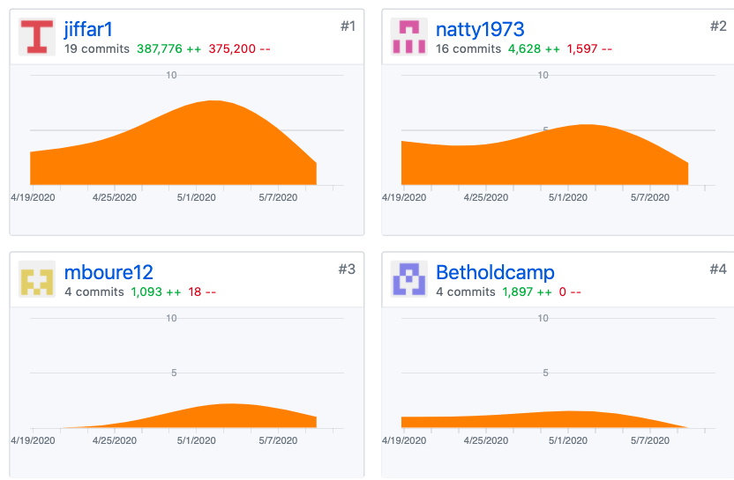
Contribution Statistics

